Slide 1
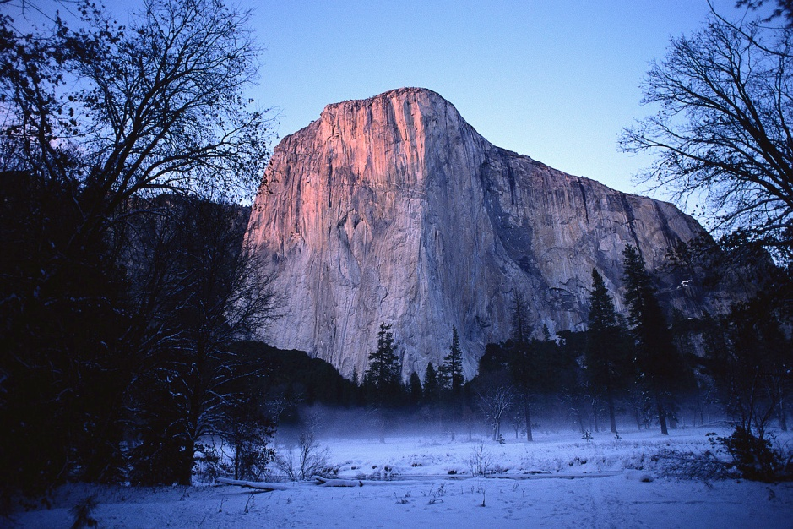
Landforms
Science Review

Slide 2
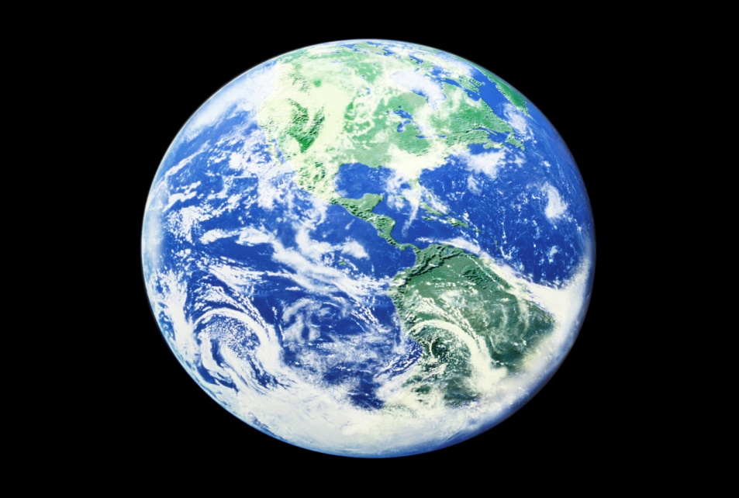
Question 1
True or False:
The Earth’s surface has changed in the past, but is no longer changing. Explain why.

Slide 3
Question 2
True or False:
Large and small particles take the same time to settle. Explain why.

Slide 4
Question 3
Weathering is the process by which rocks are broken down into smaller pieces. Give an example of weathering.

Slide 5
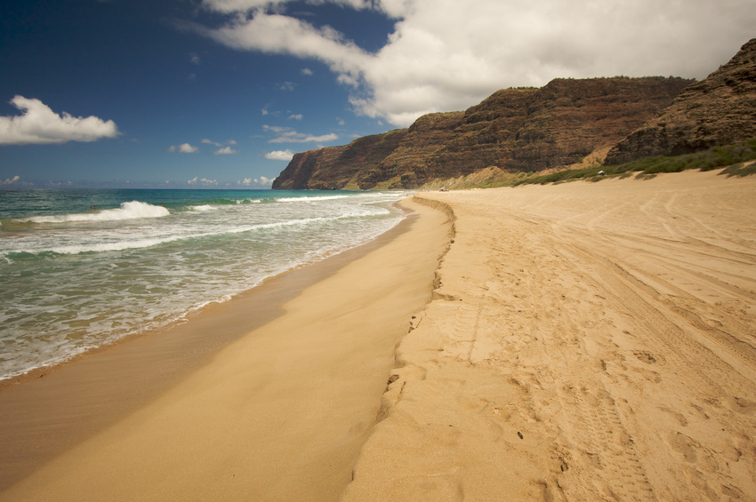
Question 4
You recently visited Ocean Isle Beach with your family and noticed that the coastline is jagged. What was the primary cause of this jagged shape?

Slide 6

Question 5
A shark tooth is found in the Rocky Mountains. The shark was known to have lived only in the ocean. What does this mean?

Slide 7
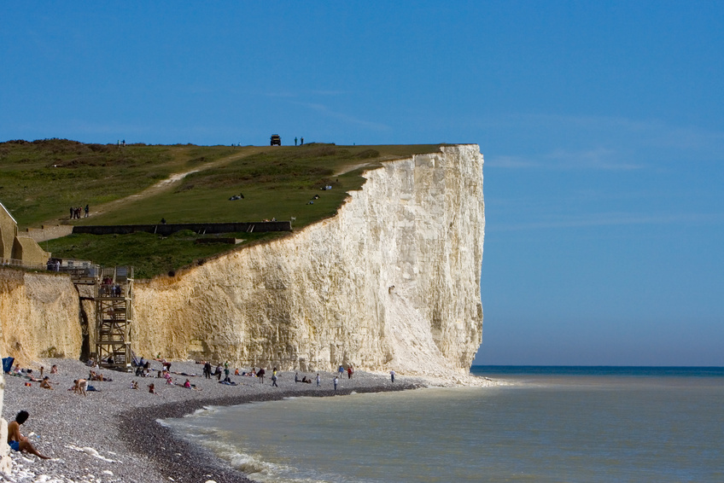
Question 6
The bottom of a cliff is worn away. Why is the cliff worn away near or under the level where the water is?

Slide 8
Question 7
True or False:
The Earth’s surface changes through slow and rapid processes. Explain why.

Slide 9
Question 8
Rain is falling down hard and fast. Name something that will help protect soil from water erosion.

Slide 10
Question 9
What is a delta?

Slide 11
Question 10
What did our stream tables help us to learn?

Slide 12
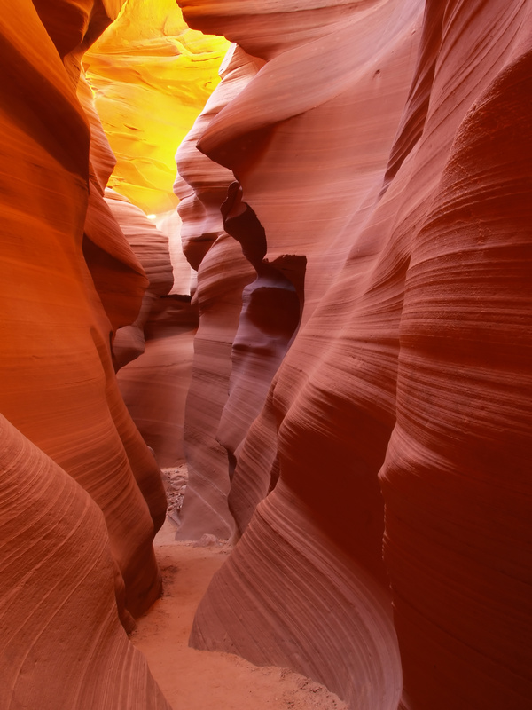
Question 11
What is the difference between erosion and weathering?

Slide 13
Question 12
What are some ways we increased the amount of erosion and deposition with our stream tables?

Slide 14
Question 13
How does gravity affect the stream-table model?

Slide 15
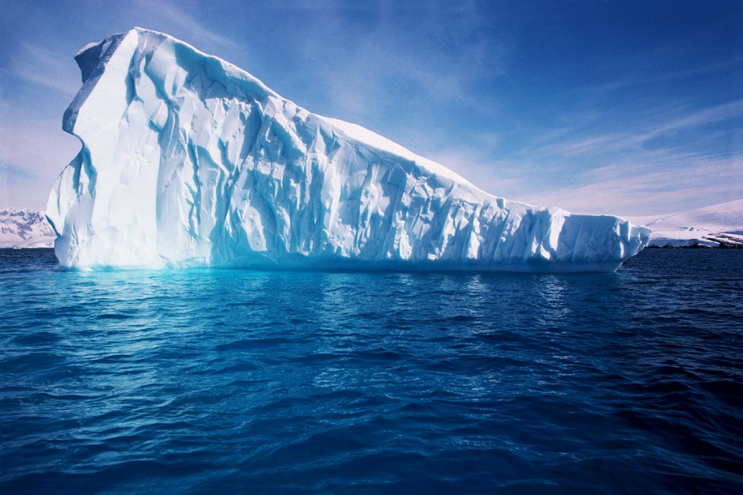
Question 14
How might ice change rocks into soil?

Slide 16
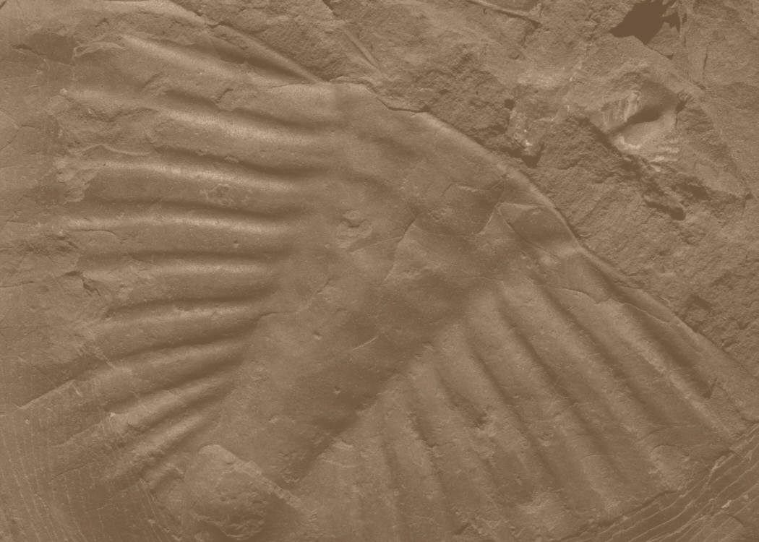
Question 15
A scientist finds a fossil of a fern near a fossil of a small mammal. Which is likely true about the organisms that made the fossils?

